Slide 1
PROTOTYPE DEVELOPMENT II
SESSION VII
PRODUCT / SERVICE PROTOTYPE

Slide 2
Learning Objectives
LO 1 : Design physical / visual representation and constructive breakthrough of business ideas

Slide 3
Subtopics
Small Data
Interview
Learn

Slide 4
Small Data

Slide 5
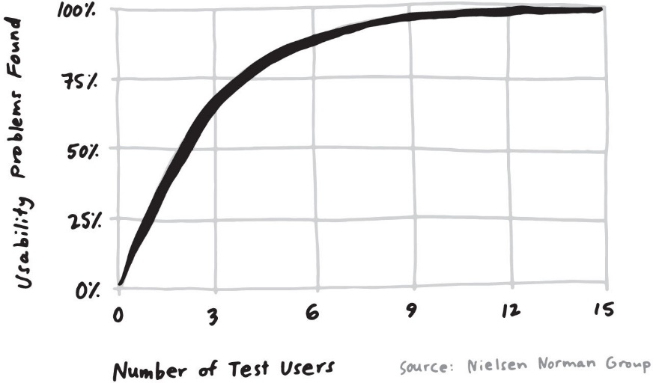
Five is the Magic Number
85 percent of the problems were observed after just five people
Testing with more people didn’t lead to many more insights—just a lot more work.
Instead of investing a great deal more time to find the last 15 percent, just fix the 85 percent and test again.

Slide 6
Five is the Magic Number
When two or three people out of five have the same strong reaction—positive or negative—you should pay attention.
The number five also happens to be very convenient. You can fit five one-hour interviews into a single day, with time for a short break between each one and a team debrief at the end

Slide 7
Interview

Slide 8
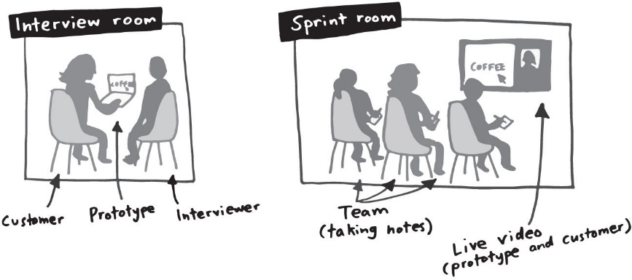
The Five-Act Interview
A friendly welcome to start the interview
A series of general, open-ended context questions about the customer
Introduction to the prototype(s)
Detailed tasks to get the customer reacting to the prototype
A quick debrief to capture the customer’s overarching thoughts and impressions

Slide 9
Act 1: Friendly Welcome
People need to feel comfortable to be open, honest, and critical. So the first job of the Interviewer is to welcome the customer and put her at ease.
The Interviewer should also ask the customer if it’s okay to record and watch the video of the interview, and he or she should make sure the customer signs any legal paperwork insisted on by your lawyers.

Slide 10
Act 2: Context Questions
Start slow by asking some questions about the customer’s life, interests, and activities
A great series of context questions starts with small talk and transitions into personal questions relevant to the sprint.
At minimum, these context questions make the customer more comfortable and forthcoming. But quite often, the answers help you understand how your product or service fits into the customer’s life—and perhaps, what people think about your competition.

Slide 11
Act 3: Introduce the Prototype(s)
Explaining that it’s a prototype encourages them to give blunt feedback and also makes the Interviewer’s job easier in case something breaks or the customer encounters a dead end (both of which are likely to happen)
Remind the customer that you’re testing the prototype—not her

Slide 12
Act 3: Introduce the Prototype(s)
“I didn’t design this” line is important, because it’s easier for customers to be honest if they don’t think the Interviewer is emotionally invested in the ideas.
Thinking aloud makes the interview format especially powerful
Seeing where customers struggle and where they succeed with your prototype is useful—but hearing their thoughts as they go is invaluable.

Slide 13
Act 4: Tasks and Nudges
Asking target customers to do realistic tasks during an interview is the best way to simulate that real-world experience.
Good task instructions are like clues for a treasure hunt—it’s no fun (and not useful) if you’re told where to go and what to do. You want to watch customers figure out the prototype on their own.

Slide 14
Act 4: Tasks and Nudges
Starting from a simple nudge, the customer reads and evaluates the app description, installs the app, and tries it out. The “how would you decide?” phrasing encourages her to act naturally along the way.
Open-ended tasks lead to interesting interviews. Overly specific tasks are boring for both the customer and the sprint team.
The Interviewer tries to keep the customer moving and thinking aloud, not anxious to find the right answer.

Slide 15
Act 5: Quick Debrief
To wrap up the interview, ask a few debrief questions
If you’re testing two or more prototypes in your interviews, review each one (to refresh the customer’s memory) and ask questions
When the interview is over, the Interviewer thanks the customer, gives her a gift card, and shows her out.

Slide 16
Act 5: Quick Debrief
Throughout the session, the Interviewer should remain engaged in the conversation. He should encourage the customer to talk while remaining neutral (say things like “uh-huh” and “mmm hmm,” not “great!” and “good job!”) There’s no need to take notes. The rest of the team in the sprint room will take care of that for you.
the script make the interviews easier to run and it will also make them consistent—which makes it easier to spot patterns throughout the day.

Slide 17
Learn

Slide 18
Watch Together, Learn Together
Watch the interviews together
It’s much faster, because everyone is absorbing the results at once
Your conclusions will be better as a group, since you have seven brains working together
You’ll avoid problems of credibility and trust, because each sprinter can see the results with his or her own eyes.
And at the end of the day, your team can make an informed decision about what to do next—the results of the interviews (and the sprint) are still clear in everyone’s short-term memory

Slide 19
Take Interview Notes as a Group
Before the first interview begins, draw a grid on a large whiteboard in the sprint room. Create five columns—one for each customer you’ll be interviewing—and a few rows—one for each prototype, or section of the prototype, or sprint question you’re trying to answer.
Distribute sticky notes and whiteboard markers to everyone in the room. Give everyone instructions for how to take notes during the interviews: “When you hear or see something interesting, write it down on a sticky note. You can write down quotes, observations, or your interpretation of what happened.”

Slide 20
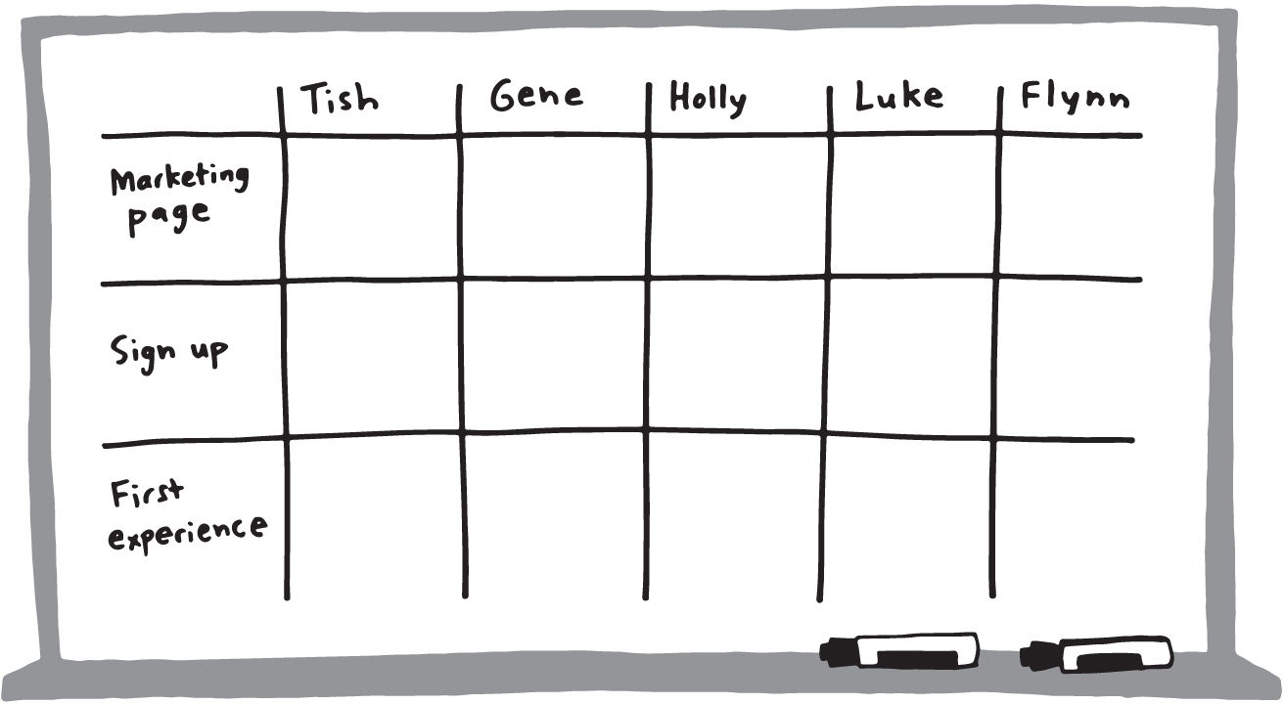
Take Interview Notes as a Group

Slide 21
Take Interview Notes as a Group
Use a different color marker depending on the note: green for positive, red for negative, black for neutral. If you only have black markers, write a plus or minus in the corner, or leave it blank for neutral.
During the interviews, the room should be quiet. It’s also important to be respectful of the customer being interviewed.
At the end of each interview, collect the notes and stick them to the whiteboard. Put them into the correct row and column, but don’t worry about any other organizing just yet. Then, take a break. Focusing and taking notes for five hours is tiring, so get some downtime between each interview.

Slide 22
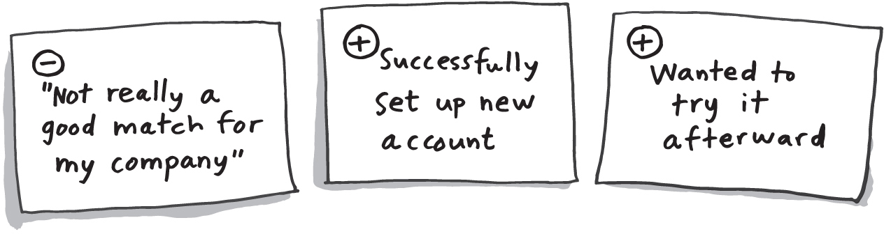
Take Interview Notes as a Group

Slide 23
Look for Patterns
Look for patterns that show up with three or more customers. If only two customers reacted in the same way but it was an especially strong reaction, make note of that, too.
After five minutes looking for patterns individually, ask the team to share what they found and read the patterns aloud. On another whiteboard, list every pattern and label each one as positive, negative, or neutral. Once the patterns are listed, it’s time to make sense of the results.

Slide 24
Student Activities

Slide 25
Student Activities
Selected teams will explain their prototype for maximum 7 minutes per team on video conference session
Students create a 3-minute video that explains their prototype
Test the prototype to minimum 3 classmates and 2 lecturers
Create feedback grid and the analysis based on the testing results
Students submit the link to the video, feedback grid and the analysis to Binusmaya INDIVIDUALLY
Prototype score will be 30% of the assignment score

Slide 26
Assignment I Scoring
Prototype: 60%
Feedback Grid: 40%
Contents:
Prototype video
Feedback grid
Analysis
Assignment I score will be 30% of the assignment score
Remember to submit Assignment I INDIVIDUALLY

Slide 27
Session 8 Preparation

Slide 28
Session 8 Preparation
Learn Key Partnership

Slide 29
References
Knapp, J., Zeratsky, J., & Kowitz, B. (2016). Sprint: How to solve big problems and test new ideas in just five days. Simon and Schuster

